Slide 1

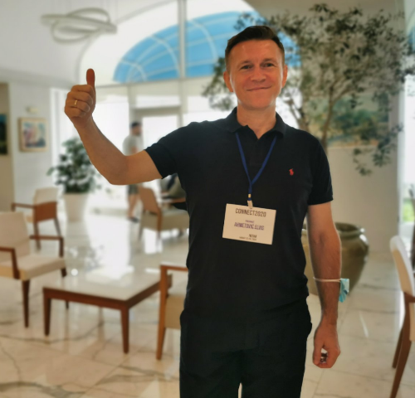
Writing project proposals
Elvis Ahmetović elvis.ahmetovic@untz.ba

Slide 2
Outline of Presentation
Motivation for writing project proposals in countries with limited research and teaching funds
Why writing project proposals is important?
What is project proposal?
Project proposal triple constraint
Important phases in a project proposal from an idea to the end of the project
Calls for project proposals
Key questions about project proposal planning and writing
Philosophy for writing project proposals and common project proposal parts
Conclusion: Tips for writing project proposal
Take home messages important for project proposal writing
Connect2020 group for writing project proposals
Acknowledments

Slide 3


Countries with Limited Research and Teaching Funds
Motivation for Writing Project Proposals in
New research & teaching knowledge, experience, skills?
New research infrastructure?
More people doing research?
Increasing number of students?
Excellence in research and teaching?

Slide 4
Why writing project proposals is important?
Get funds for our
project ideas
Address:
- global and
local issues important for our society
- knowledge gaps
Buy research and
teaching equipment
Get new knowledge,
experience and skills
Achieve excelence in
research and teaching

Slide 5
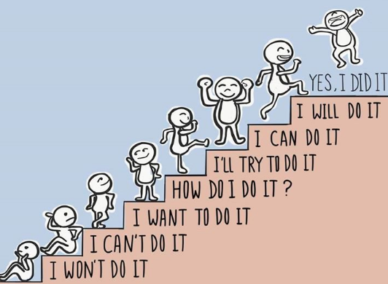


Internationalisation, Collaboration Networks, Writing and Participating in Research & Education Projects?
Global optimum!
Cut this part of feasible region!
Local
optimum
Good initialisation
Cut this part of feasible region!
This is a good lower bound!

Slide 6
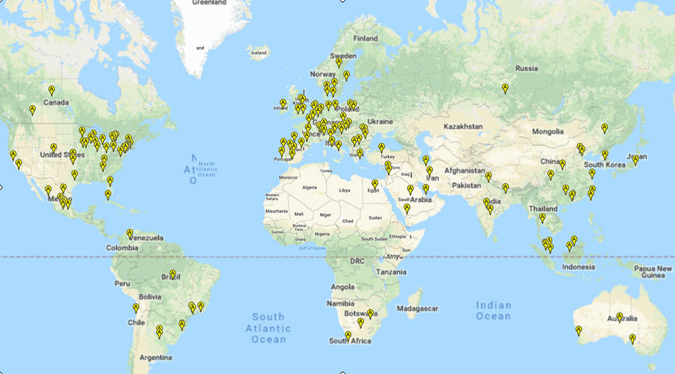
Recognition of your work over the globe is very important

Slide 7


Goals, plans and hard work are very important for everything we would like to achive including also geeting funds for projects!

Slide 8

WHAT IS PROPOSAL?
WHAT IS PROJECT?
WHAT IS PROJECT PROPOSAL?

Slide 9



Project & Proposal
Project
Proposal
a piece of planned work or an activity that is completed over a period of time and intended to achieve a particular aim/goal/purpose
a formal suggestion, plan, or idea, often a written one
the act of making a formal plan or suggestion
https://dictionary.cambridge.org/dictionary/english/project
https://dictionary.cambridge.org/dictionary/english/proposal

Slide 10
A critical document that you present to a client, sponsor or stakeholder to get your project approved or receive funding for it.
A document that outlines everything stakeholders need to know to initiate a project.
A document that facilitates a professional relationship between an organization and outside contributors.
A document that is used to convince a sponsor that a project needs to be done to solve a particular business problem or opportunity.
WHAT IS A PROJECT PROPOSAL?
A document that tell stakeholders why your project ideas should be executed.
An important document describing key details about a project.
Document
Needs to solve a problem
Project ideas
Key details about a project
Sponsors/Stakeholders
Receive funding and solve a problem

Slide 11
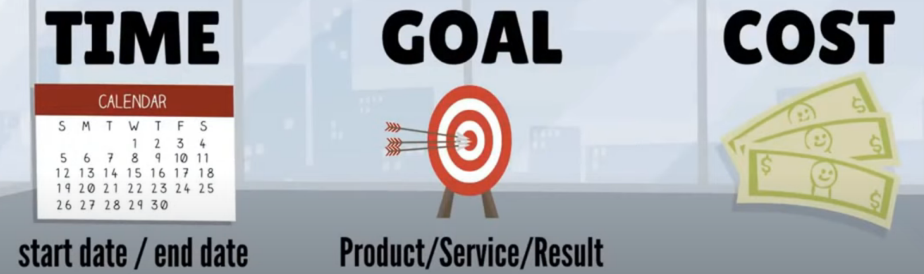
Project & Proposal
A temporary and complex initiative that is agreed, planned, and executed to achieve a specific goal (e.g. to create a unique product, service or result) with an appopirate cost/budget

Slide 12
The project management triple constraint
SCOPE
(Goal+Work)
COST
TIME

Slide 13
Important phases in a project from an idea to the end of the project
Phase 1
Project idea
Phase 2
Proposal writing
Phase 3
Proposal submission
Phase 4
Phase 5
Phase 6
Finding appropriate project call
Consortium building
Evaluation by External Experts
Grant agreement preparation & signature
Project start
Phase 7
Project end
Midterm reporting
Implementation
Final reporting

Slide 14
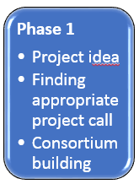
Project proposal ideas?
Market need
Business need
Technological advancement
Customer request
Social need
Ecological considerations
Do Needs
Analysis!
Ideas
What is beneficial
for our society?
Find Knowledge gaps!

Slide 15


Global Challenges We Face
Needs
Ideas
Sustainable Development Goals by 2030
https://www.un.org/sustainabledevelopment/

Slide 16

Where to find calls for project proposals?
In your country
Universities
Ministry of Education and Science
Ministry of Civil Afairs
Embassies of different countries in your home country
...
Outside your country
Projects funded by European union
Projects funded by different countries in EU and outside EU
....

Slide 17
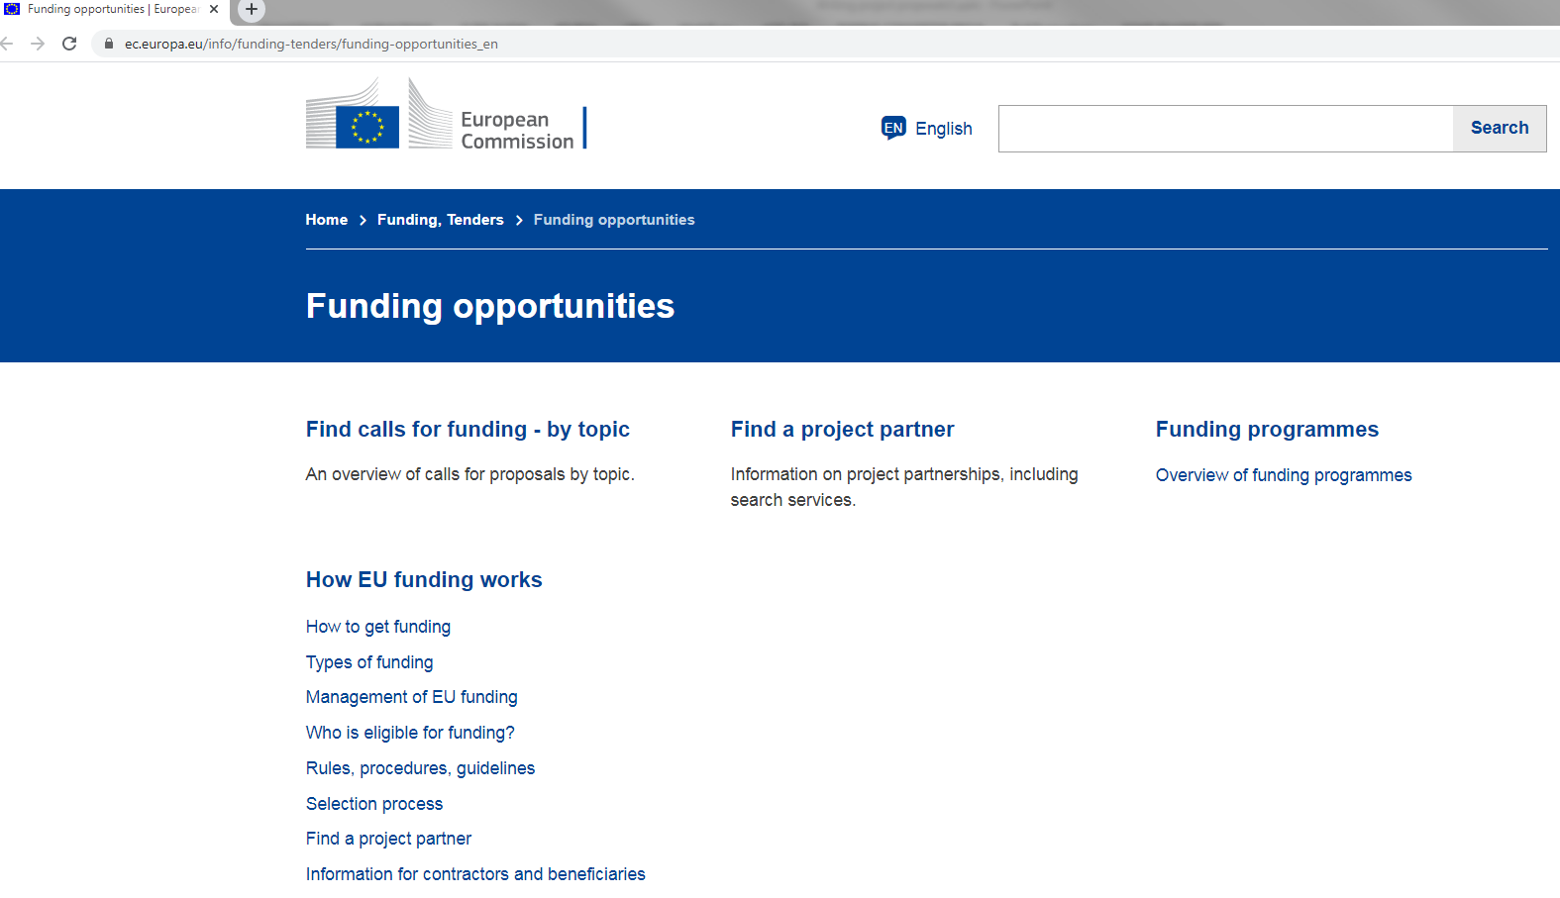
https://ec.europa.eu/info/funding-tenders/funding-opportunities_en

Slide 18

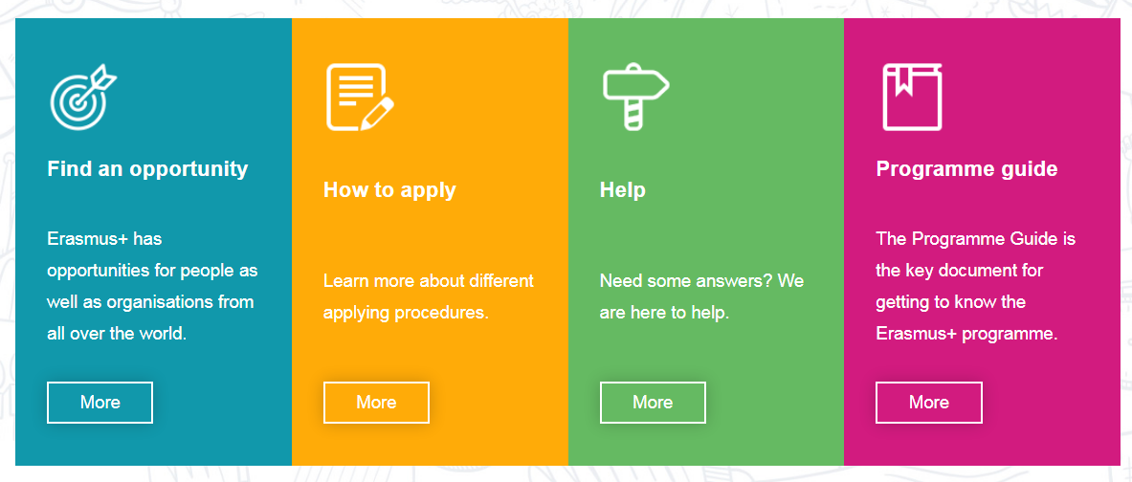
Erasmus+
https://ec.europa.eu/programmes/erasmus-plus/about_en

Slide 19

https://interbaproject.com/

Slide 20
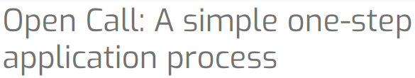


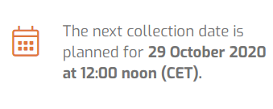
Finding project calls
https://www.cost.eu/
COST provides funds for:
organising meetings,
training schools,
short term scientific missions or
other networking activities
in a wide range of scientific topics.
Global networking promotion
of national-funded research

Slide 21
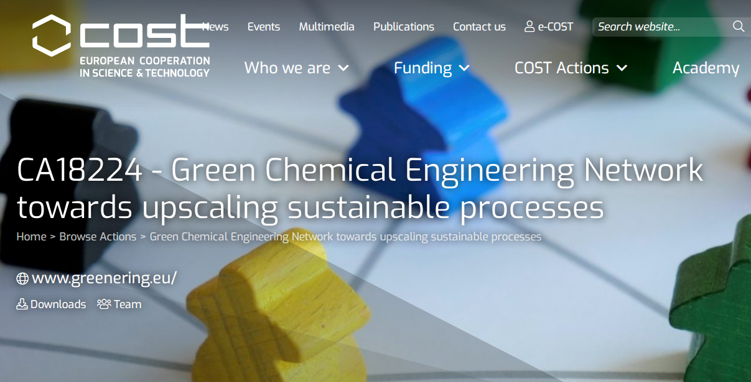

Slide 22

Marie Skłodowska-Curie Actions
https://ec.europa.eu/research/mariecurieactions/node_en
Marie S-Curie Actions
Training
Mobility
Career
ITN
Innovative Training Networks
RISE
Research & Innovation Staff Exchange
COFUND
Co-financing fellowship or doctoral programmes with transnational mobility
IF
Individual Fellowships
NIGHT
European Researchers’ Night
https://ec.europa.eu/research/mariecurieactions/actions/get-funding_en

Slide 23
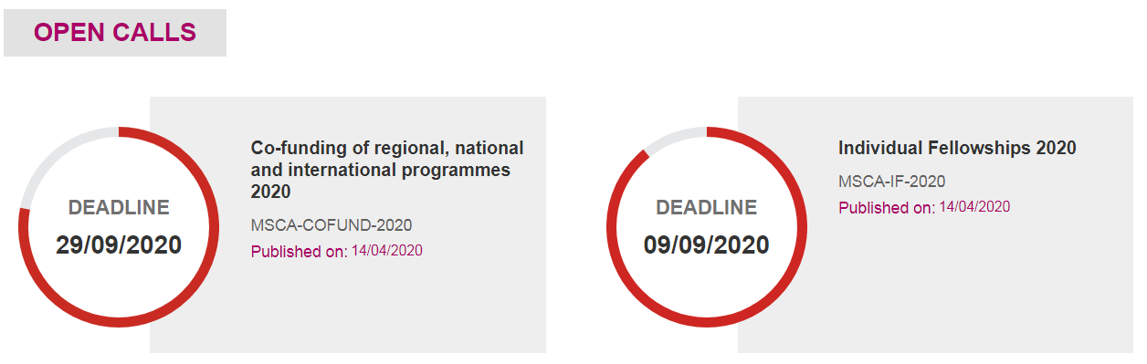
Marie Skłodowska-Curie Actions

Slide 24

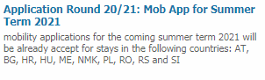
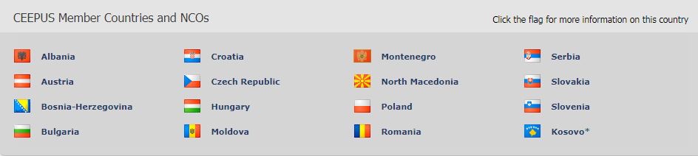
CEEPUS applications for winter term 2020
Network Mobility Applications
- Applications for the Winter Term 2020 are still possible in some CEEPUS countries
Freemover Mobility Application round started
If you want to apply as a Freemover, that means you
want to be exchanged outside a network
https://www.ceepus.info/#nbb

Slide 25
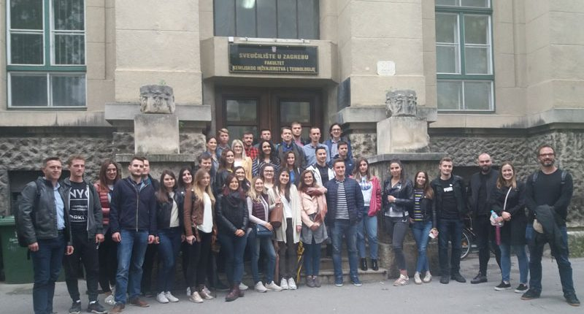




Short term excursions and summer schools
The first short-term excursion of undergraduate students from Bosnia and Herzegovina (University of Tuzla, Faculty of Technology) to Croatia (University of Zagreb, Faculty of Chemical Engineering and Technology) in the CEEPUS Network „CIII-SI-0708-06-1819-CHEMISTRY AND CHEMICAL ENGINEERING“

Slide 26



Other project and mobility funding opportunities
https://www.daad.de/en/
Austrian Agency for International Cooperation in Education and Research
https://oead.at/
There are many calls for
projects and mobilities!
Fulbright Scholar Program
https://www.cies.org/

Slide 27
Consortium building
Choose the right people/partners in your project is crucial to increase chances to have a winning project proposal and successfull project
Think about:
Complementarity (What kind of partner‘s roles and expertise’s you need for a project; Are they complementary?)
Interdisciplinarity (Do you have partners from different disciplines to bring together diverse viewpoint and knowledge?)
Balance (Do you have a balance between profit and non-profit partners, geographical diveristy of partners and gender balance?)
Excellence (Do you have partners with excellent knowledge, experience, skills, references, and results from previous projects?)

Slide 28

Key questions about project proposal planning?
Idea, action, event, thing
Phase 2
Proposal writing
People/partners
Way, quantity, quality
Place
Time
Reason/Because

Slide 29

Some questions about project proposal planning and writing
What do you want to do and achieve? (describe scope, limits, objectives and expected impact)
Why are you doing it? (need to find solution for a problem and/or address to local/globall issues )
Who is involved in doing it? (describe partners and their roles in a project; do you have agreements with all partners?)
How and When it will be done? (describe methodology, work packages assigned to partners, project management, resources and time for finishing project activities)
What is likely to go wrong? (describe risk mitigation planning to avoid unexpected situations in your project)
What you will do with your project results? (describe dissemination and exploitation of the project results)
How much is it going to cost? (describe budget plan)

Slide 30

Some questions about project proposal planning and writing
Why your project should be supported compared to other good projects? (describe added values of your project related to project call requirements)
Are your project results measurable?
Do you have an appropirate gender balance of people involved in your project?
Do you have parners from different institutions (universities, non-government organisations, companies, institutes) and geographical diversity?
What is your finacial and in-kind contribution in the project?
Do you have realistic ratio between requested funding and work done in the project? (be careful as some applicants can offer the same work for less money and their project can be accepted)

Slide 31
Philosophy for writing projects
Generic (applicable to all projects)
Independent of the subject or topic
Independent of the funding sources
Independent of the programme

Slide 32

Project proposal
Title
Acronym
Agreement between partners
Summary
List of partners and their role in the project
Description of the project relevance
Description of project design and implementation
Description of project team
Description of impact, dissemination, sustainability
What are common
project proposal
parts?

Slide 33

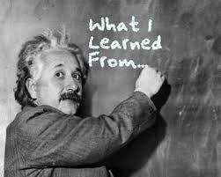
Tips for writing a project proposal
Set realistic goals, time framework, and budget
Make balance between goals, work to be done, time, and budget
You have to convince the funding sources to give you the money
Write a compettive project proposal compared to others good proposals
Write the best project proposal you can and avoid any type of errors
Clearly show need analysis, project activities, team, budget, impact and dissemination of results, risk mitigation plan, sustainability of the project
Try to do the best and
write an excellent
project proposal because acceptance rates are around 10-20%!

Slide 34
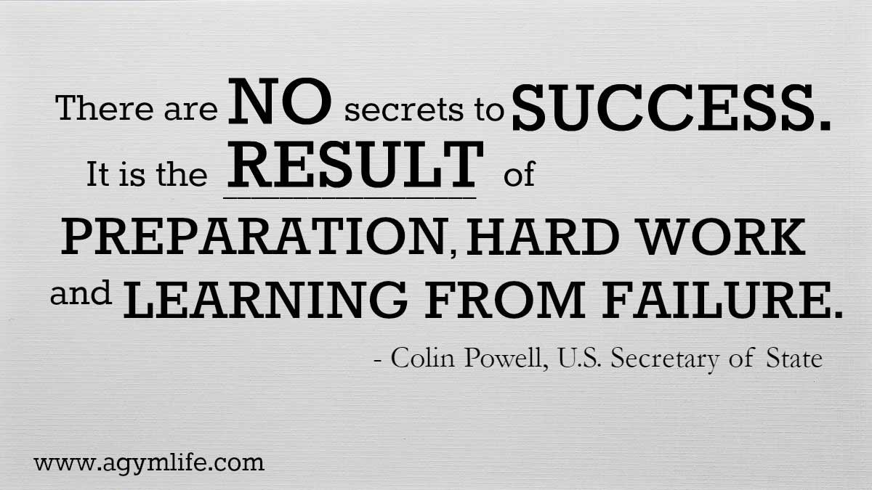


Slide 35

https://ec.europa.eu/info/research-and-innovation/events/upcoming-events/european-research-and-innovation-days_en

Slide 36

https://ec.europa.eu/research/mariecurieactions/events/science-wonderful-2020_en

Slide 37

Some references and useful web links:
https://www.fool.com/the-blueprint/project-proposal/
https://www.indeed.com/career-advice/career-development/how-to-write-a-project-proposal
https://blog.bit.ai/how-to-write-a-project-proposal/
https://www.slideshare.net/donruca/how-to-write-good-scientific-project-proposals-a-comprehensive-guide
https://www.wrike.com/blog/overlooked-project-proposal-outline/
https://www.projectsmart.co.uk/writing-a-project-proposal.php
https://www.2webdesign.com/blog/7-answers-to-the-most-frequently-asked-questions-about-seo/
https://www.indeed.com/career-advice/career-development/how-to-write-a-project-proposal
https://www.youtube.com/watch?v=8cUwqxDrGYM
https://www.youtube.com/watch?v=3jSQU-_tdA4
https://www.mavenlink.com/resources/project-proposal
https://www.umass.edu/cfr/grant-writing/questions-think-about-when-planning-project
http://h2020.com.ua/wp-content/uploads/2016/03/proposal-writing_final_kiev_GWcom.pptx
https://www.slideshare.net/vricigliano/wh-questions-10147805
https://www.projectsmart.co.uk/managing-small-projects.php
https://utt.edu.tt/documents/files/9th_edf_project_proposal_template.pdf
https://wbc-rti.info/
https://www.aib.edu.au/blog/career-development/how-setting-goals-can-improve-your-work-performance/

Slide 38



Acknowledments
https://www.connect2020.online/

Slide 39
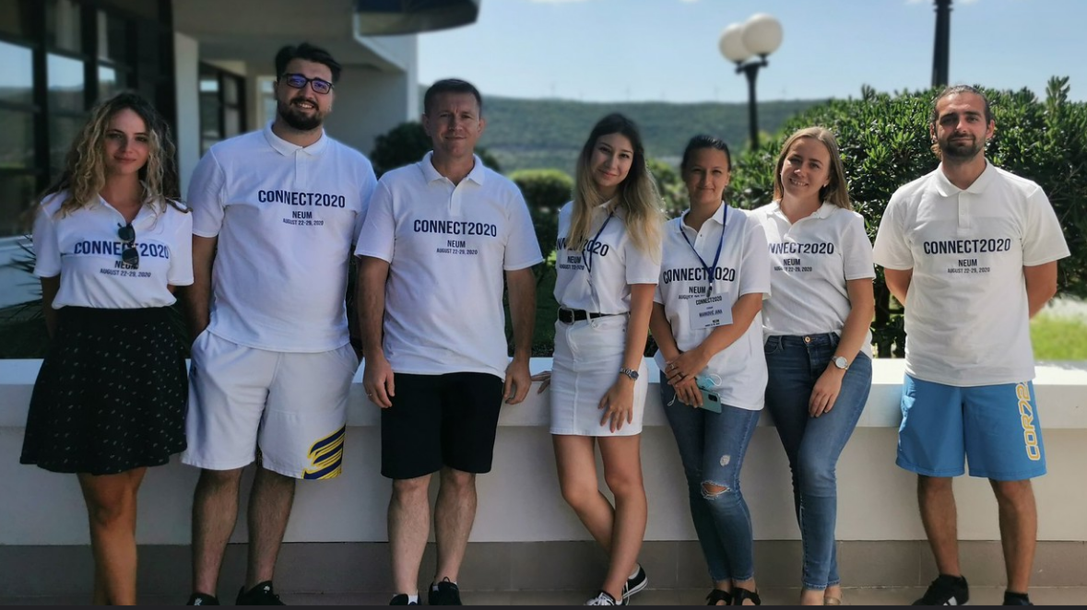
Connect2020 group for writing project proposals

Slide 40
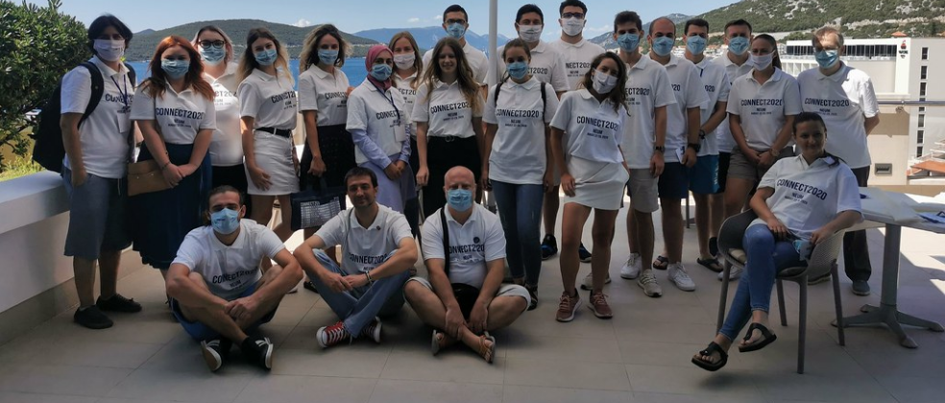
CONNECT2020 OPPORTUNITIES: Meet new friends, exchange experience and ideas, learn a lot of new things, enjoy spending time together, and have a fun!

